Slide 1

News, December 2014

Slide 2

PyData NYC: the review
Was SOLD OUT, three tracks, pydata.org/nyc2014/schedule/
Reviews at jvns.ca and mdbecker.github.io

Slide 3
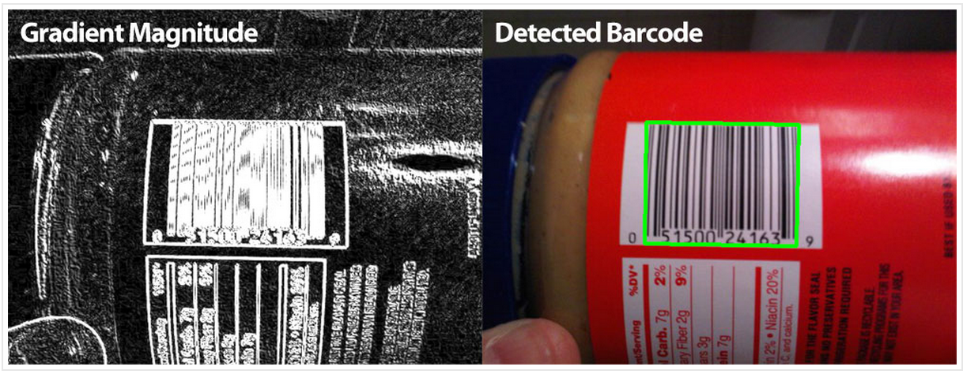
Detecting Barcodes in Images with Python and OpenCV
OpenCV and python bindings to detect barcodes
http://www.pyimagesearch.com/2014/11/24/detecting-barcodes-images-python-opencv

Slide 4

Recruiter etiquette
Popularity of a Meetup attracts recruiters.
We ask recruiters to be polite.
Whose looking to be recruited?

Slide 5
Our most loyal attendee is!
zheng zhu

Slide 6
POTM: collections
Standard library with a number of efficient data structures
namedtuple | Tuple with named fields
deque | list-like container with fast appends and pop
Counter | counting hashable objects
OrderedDict | the order entries were added
defaultdict | Dict subclass that supply missing values

Slide 7
PyData London 2015!!!!
Updates

